Slide 1

MTECH - Computer Science and Engineering (Big Data Analytics)
EVIDENCE GUIDED MULTIMODAL FAKE NEWS DETECTION USING TEXT – IMAGE CONSISTENCY AND EXTERNAL KNOWLEDGE
PRESENTED BY:
M.HARI SRINIVAS – 24MCB0045
UNDER THE GUIDANCE: DR.V. RAKHI MOL(PHD) - SCOPE

Slide 2
SYNOPSIS
This project focuses on improving the reliability of fake news detection by moving beyond traditional text-based approaches and introducing a more comprehensive verification process. Instead of relying only on patterns learned from data, the system attempts to understand the context of a news claim and validate it using multiple perspectives. It first analyzes the meaning of the text and checks whether the accompanying image is contextually relevant or misleading. To strengthen the decision-making process, the system retrieves related information from external knowledge sources and evaluates whether the claim is supported by credible evidence. These different insights are then combined to make a final prediction. In addition, the system provides a clear explanation of its decision, helping users understand the reasoning behind whether a piece of news is classified as fake or real. This approach makes the system more practical and trustworthy for real-world scenarios.

Slide 3
INTRODUCTION
Social media platforms enable the rapid and large-scale dissemination of information, allowing news to reach millions of users within a very short time.
Fake news often spreads faster than verified information due to sensational content, emotional language, and high user engagement.
Modern fake news frequently combines misleading textual claims with unrelated or manipulated images, increasing the complexity of detection.
Traditional fake news detection models primarily rely on pattern-based learning and lack factual grounding, which limits their reliability on unseen or evolving content.
Explainability has become a critical requirement, as users and authorities must understand why a piece of information is classified as fake or real.

Slide 4
PROBLEM STATEMENT
Social media platforms generate an enormous volume of content every day, making manual verification of news impractical. Fake news often appears in the form of convincing text supported by misleading or unrelated images, which existing detection systems fail to analyze jointly. Many current approaches depend heavily on fully labeled datasets and struggle to adapt to new or unseen misinformation. In addition, the absence of factual verification mechanisms leads to low trust in automated predictions. This project addresses these challenges by developing a system capable of analyzing multimodal content, utilizing both labeled and unlabeled data, and grounding decisions in retrieved evidence to enable reliable and explainable fake news detection.

Slide 5
OBJECTIVES
The primary objectives of this project are:
To design a multimodal fake news detection system that jointly analyzes textual and visual content from social media posts.
Incorporate image–text consistency modeling using pretrained multimodal representations.
Integrate a retrieval-augmented evidence verification mechanism that grounds predictions in external factual sources.
Develop a feature fusion strategy that combines textual features, visual consistency scores, and evidence consistency measures.
To build a supervised classification model capable of producing reliable fake/real predictions with confidence scores.
To provide explainable and evidence-backed reasoning using an LLM-based explainability module.
Demonstrate the system through an interactive dashboard that supports real-time user input and output visualization.

Slide 6
LITERATURE REVIEW
Paper Title | Author and Year | Main Focus | Methodology | Limitations
Comparison of CNN Model with Different Machine Learning Models for Fake News Detection | Benaouda et al. IEEE, 2024 | Performance comparison of ML vs CNN for fake news | TF-IDF features, Logistic Regression, SVM, Random Forest, CNN | Text-only,no images, fully supervised, no explainability, dataset-specific generalization
NLP-Driven Fake News Detection: A Machine Learning Perspective | Coban and Bakal IEEE, 2025 | NLP-based fake news classification | Bag-of-Words, TF-IDF, SVM, Naïve Bayes, Logistic Regression | Ignores visual content, no fact verification, no reasoning, sensitive to feature engineering
Multi-Modal Fake News Detection with MF-BERT | Reddy et al., IEEE, 2025 | Multimodal fake news detection | BERT (text) + CNN (image) + feature fusion | No factual grounding, no explainability, fully supervised, correlation-based

Slide 7
Paper Title | Author and year | Main Focus | Methodology | Limitations
Multimodal Fake News Detection using CLIP | Zhou et al., 2024 | Image–text alignment for fake news | CLIP embeddings + classifier | No external knowledge, no explainability
Graph Neural Networks for the Development of Efficient Fake News Detection | Mishra et al., IEEE, 2025 | Propagation-based fake news detection | GNNs using social and diffusion graphs | Weak content understanding, no factual grounding, no multimodal reasoning
LLM-Based Fake News Detection Framework with RAG Fact-Checking | Bai and Fu, IEEE BigData, 2024 | LLM + RAG-based fake news verification | Claim extraction + RAG + LLM inference | Total dependency on LLM, no Graph propagation module with similarity
An Information Reliability Framework for Detecting Misinformation Based on LLMs | Turaga et al., IEEE BigData, 2024 | Information reliability using LLMs and RAG | LLM reasoning + retrieval-based evidence | Text-only, no image analysis, ni text image similarity, no virality modeling

Slide 8
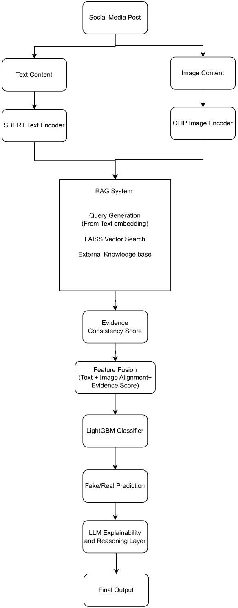
OVERALL EXPLANATION WITH DESIGN DIAGRAM

Slide 9
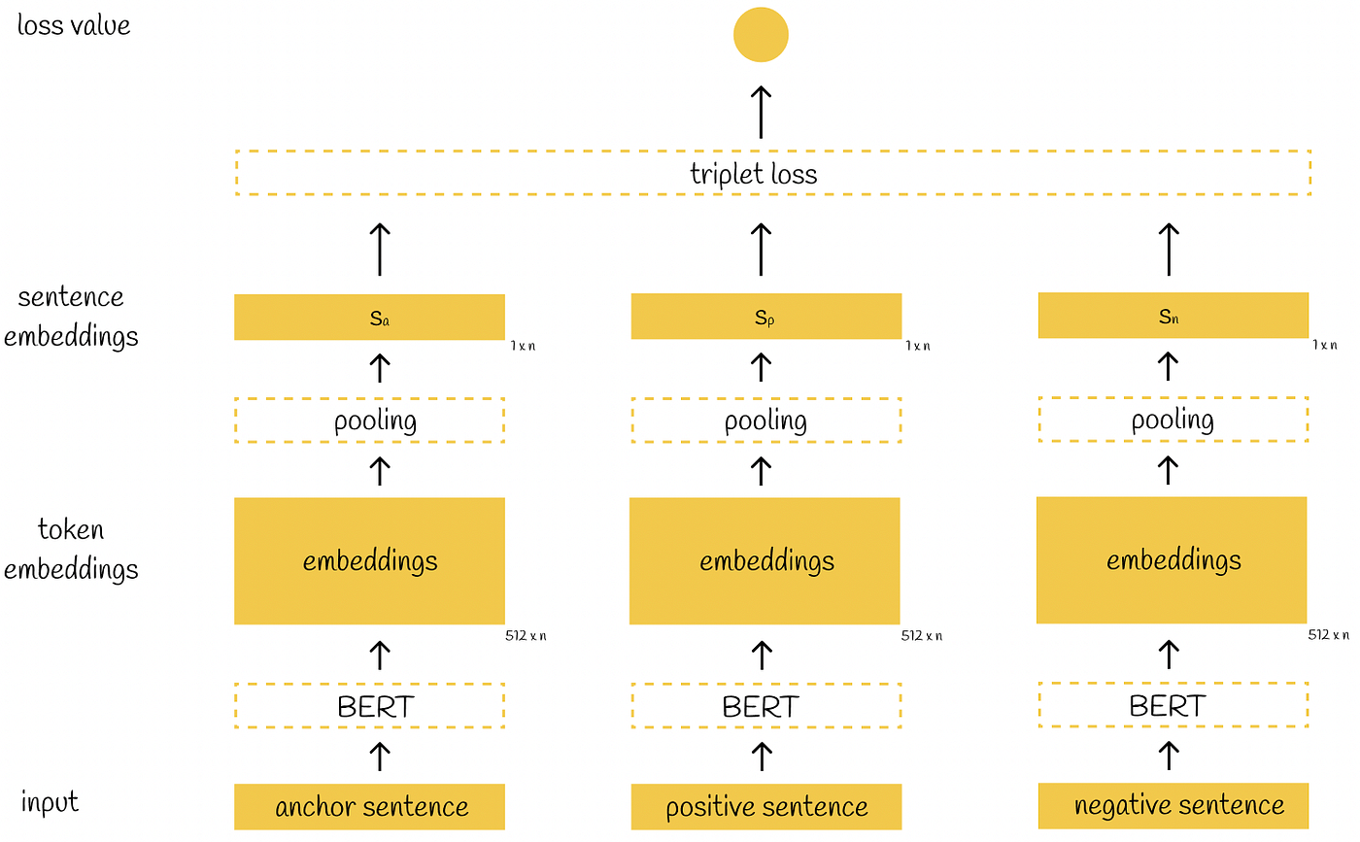
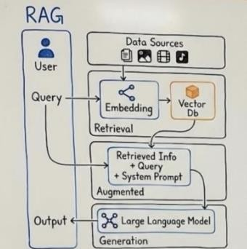
OVERALL EXPLANATION WITH DESIGN DIAGRAM
Conceptual Diagram of RAG Architecture
Sentence-BERT Diagram

Slide 10
OVERALL EXPLANATION WITH DESIGN DIAGRAM
The novelty of the proposed system lies in its three-level verification strategy. First, it evaluates semantic consistency between textual claims and associated images using a pretrained CLIP model, capturing misleading visual-contextual relationships. Second, it verifies textual claims against external factual sources through a retrieval-augmented generation (RAG) system that retrieves relevant evidence from knowledge bases such as Wikipedia and fact-check repositories. Third, it fuses these multimodal and evidence-based signals using a supervised learning model to generate robust predictions.
Furthermore, the system incorporates an LLM-based explainability module that translates model decisions into human-readable explanations grounded in retrieved evidence. This combination of multimodal consistency, factual grounding, and explainable reasoning distinguishes the proposed system from existing fake news detection approaches and enhances its applicability in real-world information verification scenarios.

Slide 11
OVERALL EXPLANATION WITH DESIGN DIAGRAM
The system begins by taking a news headline along with its corresponding image as input, since fake news often combines both text and visuals.
The textual part is processed using SBERT, which helps in understanding the actual meaning of the sentence rather than just keywords.
At the same time, the CLIP model checks whether the image truly matches the context of the text or if it is misleading.
To make the system more reliable, a RAG-based approach is used to fetch relevant information from external sources using FAISS.
The retrieved evidence is then passed to an NLI model, which determines whether the claim is supported, contradicted, or unrelated.
All these outputs - text understanding, image consistency, and evidence verification — are combined together in a feature fusion step.
Finally, a LightGBM model uses this combined information to classify the news as fake or real, along with a confidence score.

Slide 12
DATA COLLECTION
FakeReddit (Fakeddit) Dataset
The FakeReddit (Fakeddit) dataset is a large-scale multimodal benchmark for fake news detection, consisting of over 100K Reddit posts with text, images, and metadata with 50k is used in training data.
Each sample includes a news headline, associated image, and labels for classification (binary or multi-class), enabling both unimodal and multimodal learning.
In this project, a subset of ~20,000 samples is used, focusing on text (clean_title), image URLs, and binary labels for fake/real classification.
Kaggle Fakereddit Dataset: https://www.kaggle.com/code/vanshikavmittal/fakeddit-multimodal-fake-news-classification/input
Fakereddit Dataset paper link: https://doi.org/10.48550/arXiv.1911.03854

Slide 13
IMPLEMENTATION TOOLS/SOFTWARE (MODELS)
SOFTWARE TOOLS
Tool | Purpose
SBERT | Generates contextual embeddings from textual data
CLIP | Evaluates semantic consistency between image and text
RAG | Retrieves external evidence for fact verification
FAISS | Performs fast similarity search for evidence retrieval
BART-MNLI | Verifies whether evidence supports or contradicts the claim
LightGBM | Performs final classification of fake or real news
Gemini API (LLM) | Generates human-readable explanations
Streamlit | Provides interactive user interface for testing
Google Colab | Used for model training and experimentation
HARDWARE TOOLS
Tool | Purpose
Laptop/PC | Used for model development and execution
GPU (Optional) | Accelerates training and inference processes
Internet Connection | Required for API access and data retrieval
Storage System | Stores dataset, models, and results

Slide 14
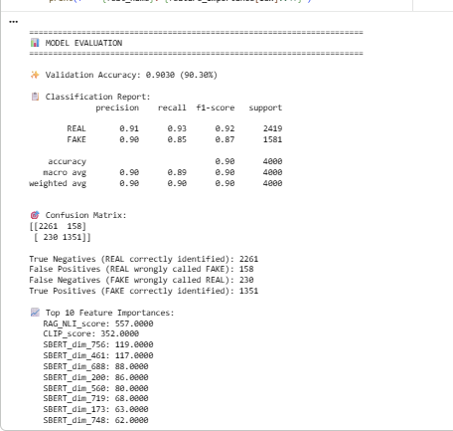
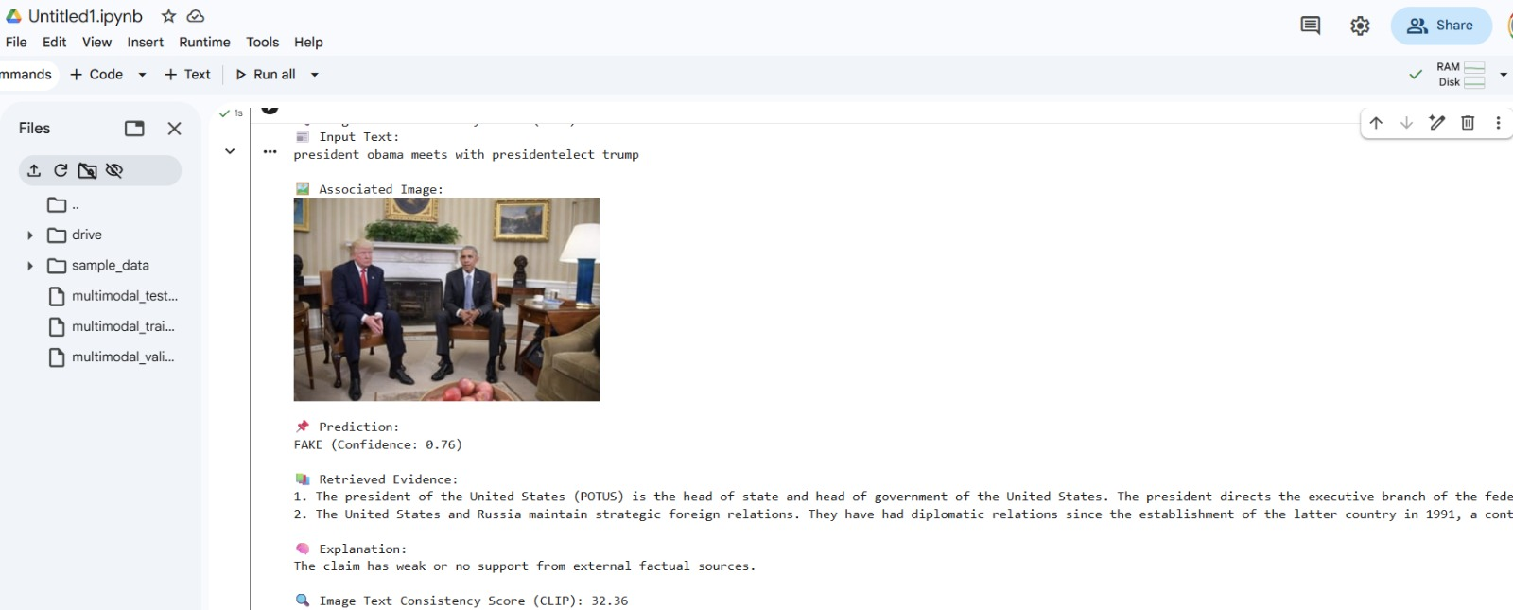
OUTPUT
Classification report:
EXAMPLE FROM DATASET:

Slide 15
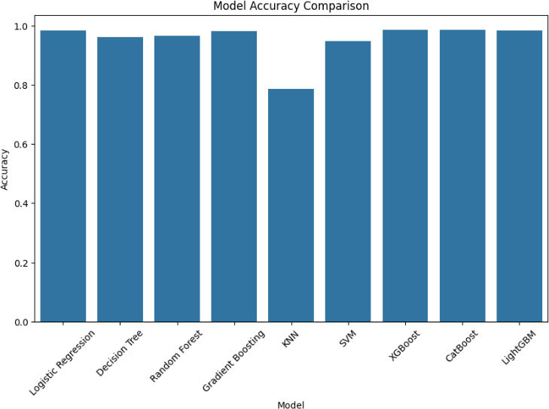
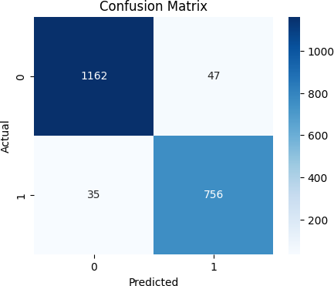
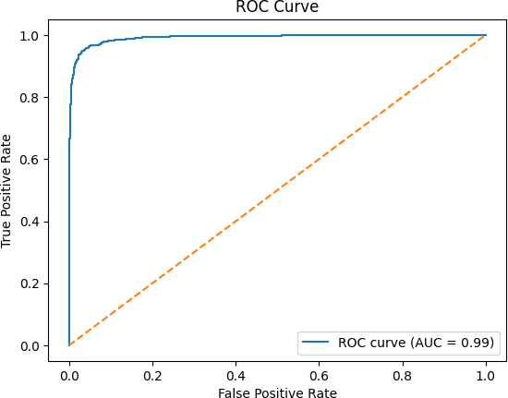
COMPARISIONS AND ABALATION STUDIES

Slide 16
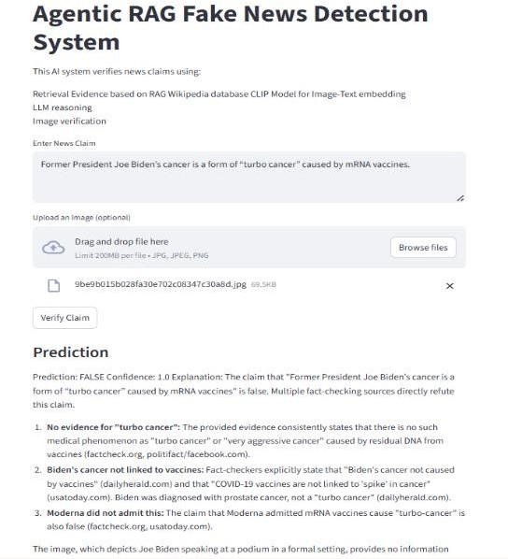
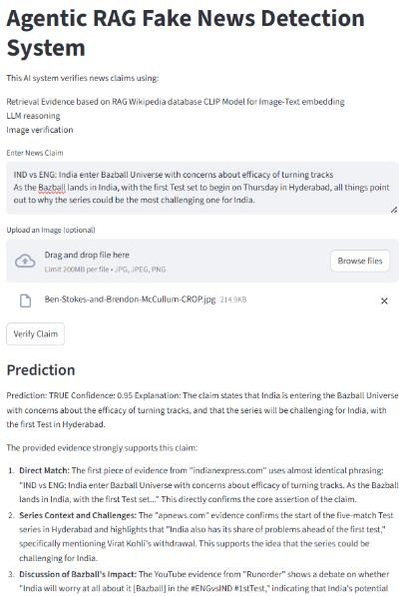
Final Output with Example : Fake news claim
Final Output with Example : Real news Claim

Slide 17
CONCLUSION
This project presents a robust and explainable multimodal fake news detection system that integrates retrieval-based reasoning, image–text verification, semi-supervised learning, and graph analysis. By leveraging large-scale datasets and open-source AI models, the system achieves improved detection performance while remaining cost-effective and suitable for real-world deployment on social media platforms.

Slide 18
FUTURE ENHANCEMENTS
In the future, the system can be extended to work with real-time data from social media platforms, allowing it to detect fake news as it spreads rather than after the fact.
More advanced multimodal models can be incorporated to improve the system’s ability to understand complex relationships between text and images.
The model can also be enhanced by studying how fake news spreads over time using graph-based approaches, which can help in identifying viral misinformation patterns.
Expanding the system to support multiple languages would make it more useful in global scenarios where misinformation is not limited to a single language.
Finally, the entire framework can be developed into a scalable application, making it accessible as a web or mobile platform for real-world use.

Slide 19
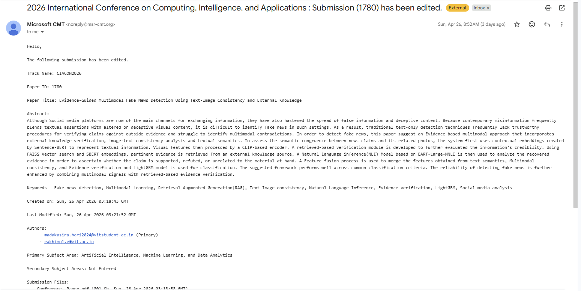
OUTCOME

Slide 20
REFERENCES
1] W. Benaouda, S. Ouamour, and H. Sayoud, "Comparison of CNN Model with Different Machine Learning Models for Fake News Detection," in 2024 1st International Conference on Electrical, Computer, Telecommunication and Energy Technologies (ECTE-Tech), 2024, pp. 1-6, doi: 10.1109/ECTE-TECH62477.2024.10851137.
[2] M. K. Çoban and G. Bakal, "NLP-Driven Fake News Detection: A Machine Learning Perspective," in 2025 7th International Congress on Human-Computer Interaction, Optimization and Robotic Applications (ICHORA), 2025, pp. 1-6, doi: 10.1109/ICHORA65333.2025.11017210.
[3]K. Reddy R, S. Sumanth B, Pragnya P, D. Reddy P, and Dr. P. M. Jyosthna, "Multi-Modal Fake News Detection with MF-BERT," in 2025 International Conference on Computing Technologies (ICOCT), 2025, pp. 1-6, doi: 10.1109/ICOCT64433.2025.11118703.
[4] Y. Zhou, Q. Ying, Z. Qian, S. Li, and X. Zhang, "Multimodal Fake News Detection via CLIP-Guided Learning," arXiv preprint arXiv:2205.14304, 2022.
[5] S. Mishra, S. Arora, N. Kumar, O. Agarwal, and C. Mehta, "Graph Neural Networks for the Development of Efficient Fake News Detection," in 2025 International Conference on Cognitive Computing in Engineering, Communications, Sciences and Biomedical Health Informatics (IC3ECSBHI), 2025, pp. 1011-1014, doi: 10.1109/IC3ECSBHI63591.2025.10990891.
[6] Y. Bai and K. Fu, "A Large Language Model-based Fake News Detection Framework with RAG Fact-Checking," in 2024 IEEE International Conference on Big Data (Big Data), 2024, pp. 8617-8619, doi: 10.1109/BigData62323.2024.10826000.
[7] V. S. P. Turaga and A. S. Namin, "An Information Reliability Framework for Detecting Misinformation based on Large Language Models," in 2024 IEEE International Conference on Big Data (Big Data), 2024, pp. 3599-3607, doi: 10.1109/BigData62323.2024.10826052.

Slide 21
TIMELINE OF THE PROJECT
Task | December | January | February | March
Literature Review
Data Set and Basic Preprocessing
Implementing RAG model completely and Ablation studies
Accessing LLM for Final Output and Testing the Model for Report Analysis and Deploying the End Goal

Slide 22
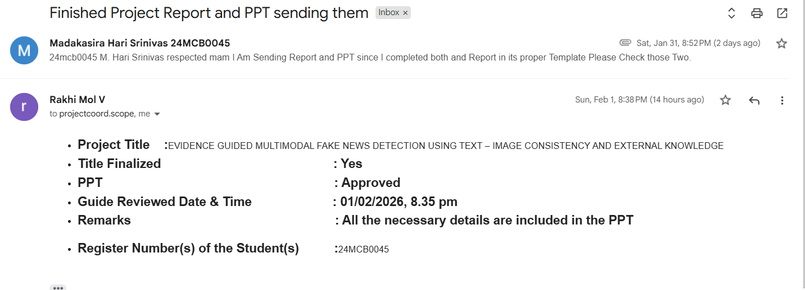

Slide 23
THANK YOU

